Slide 1
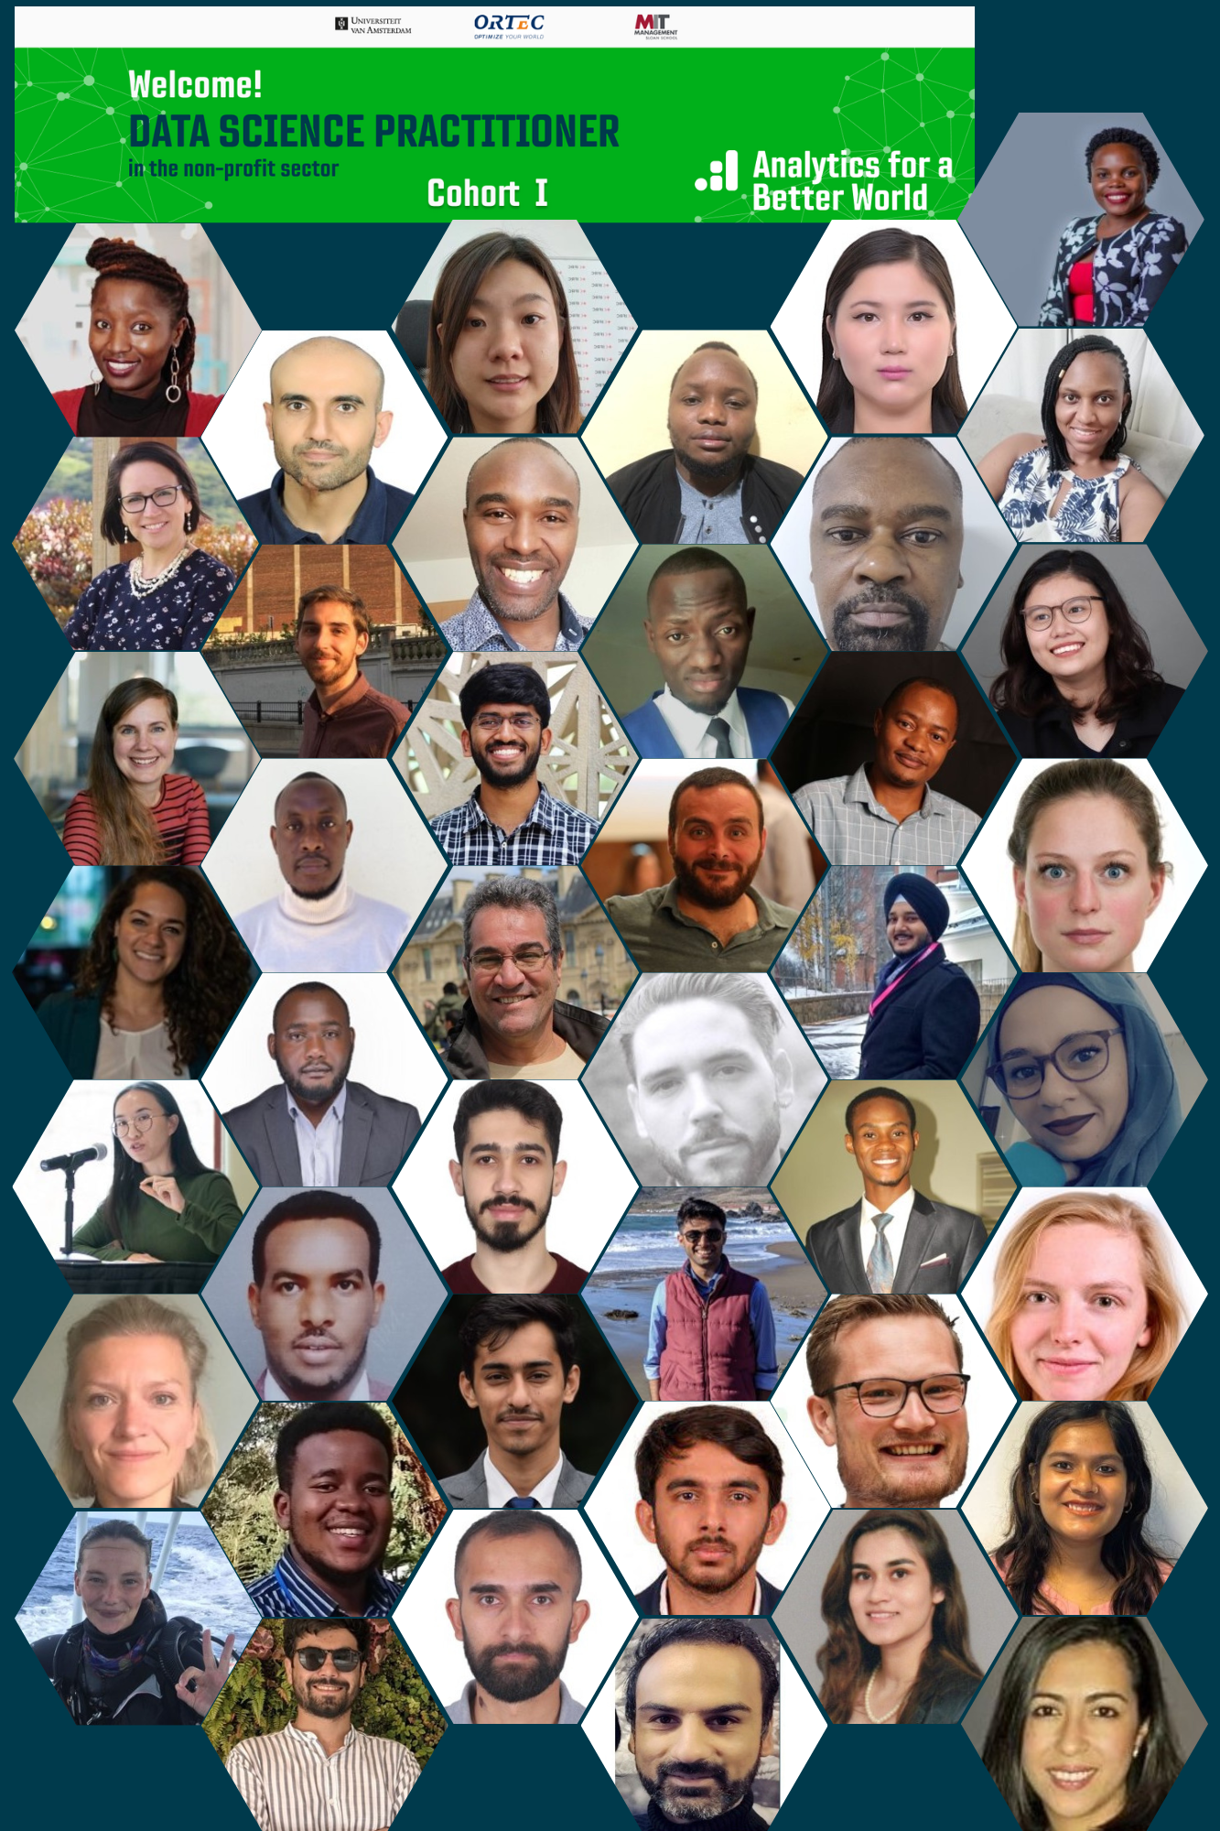
Data Science Practitioner
Fellowship Cohort 2022
Final Project Presentation
ROAD EXTRACTION FROM HIGH RESOLUTION SATELLITE IMAGERY THROUGH DEEP LEARNING NEURAL NETWORK MODEL (SAT2GRAPH)
BENSON GACHAGA
UN(UNMIK)
LOKENDRA CHAUHAN
6th December 2022

Slide 2



Business Case
The Sustainable Development Goals 2022
GOAL 9: Target 9.1.1: SDG indicator 9.1.1 being measured as the proportion of the rural population with access. resilient transport infrastructure socio-economic development, supply chains
-1/3 of the global rural population—approximately one billion people—live farther than 2 km from an all-season road- access to essential services
-Infrastructure supports 72% of the SDGs- spending on infrastructure is still prioritized for urban development
-Earth observation, satellite imagery, and geospatial data- unlock insights
-Improvement of the road network
- Free satellite imagery (Google Earth) fewer updates especially in the remote areas- clouds, low resolution

Slide 3
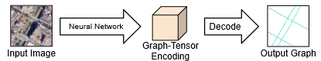
Methods or Tools Used
METHOD:
-Goal- use advanced deep learning algorithms to train a model using satellite imagery (World View 3 (Spatial Resolution-30cm))
-Sat2Graph model potential tool for use –combines traditional segmentation-based approach and graph-based approaches to create a robust algorithm
-Sat2Graph -novel encoding scheme, 3D graph-tensor encoding (GTE),encodes the road network graph into a tensor representation- road network graph
- Train simple, non-reccurrent, neural network model- directly map the input satellite imagery into the road network graph (edges and vertices)
Images obtained from ABW 2022 Geospatial Lectures by Ehsan Ullah

Slide 4
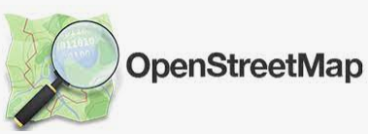

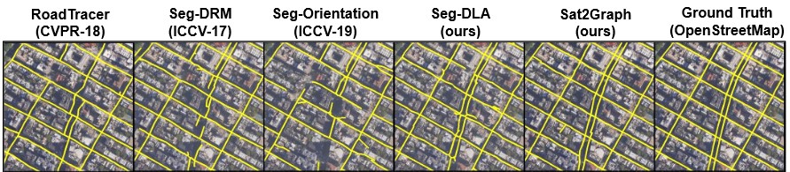
Most Significant Change (can be a forecast)
Describe here the Most Significant Change (impact) you expect after implementing the project, on:
The work you do- Geospatial developer- this model, though intensive to run, saves time, accurate results >99% than Opensource -volunteers (80%)
Your Organization- Most accurate and dependable road network - this technology will simplify the current mapping workflows
The Sustainable Development Goals- improved access and mobility improves decision making in achieving all the 17 SDGs
Demo: https://qen.ai/technology/

Slide 5
Key Learnings
Mention here your Key Learnings (from the fellowship and the project implementation)
-Assessment of Data Maturity
-Fellowship was very crucial to improve skills in modelling, dealing with stakeholders
-Improved ability to use data analytics toolboxes to solve problems
-Improved skills in data visualization and data story telling
Next Steps (how do u plan to take your project forward using what you learned during the fellowship)
-Train the model using the available resources in GoogleColab
-Share results/ Sat2Graph model in UN GIS working groups- recommend adoption

Slide 6
References
https://github.com/songtaohe/Sat2Graph
https://unstats.un.org/sdgs/report/2022/The-Sustainable-Development-Goals-Report-2022.pdf
https://sdgs.un.org/sites/default/files/documents/8656Analysis%2520of%2520transport%2520relevance%2520of%2520SDGs.pdf
https://www.mdpi.com/2071-1050/14/4/2149
https://dgv4-cms-production.s3.amazonaws.com/uploads/document/file/169/DG_UNSDG_eBook_1-7-2019_digital_final.pdf
Geospatial lectures ABW 2022 by Ehsan Ullah

Slide 7
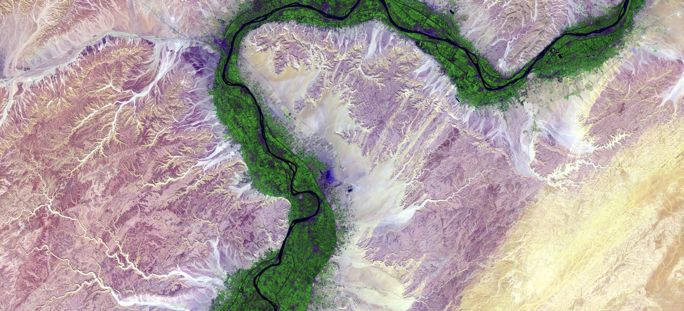
Thank you for your attention!
https://analyticsbw.org/
https://www.linkedin.com/company/analytics-for-a-better-world/
academy@analyticsbetterworld.org

